Slide 1
Assessment Task 4 Feedback
1/5/2018

Slide 2
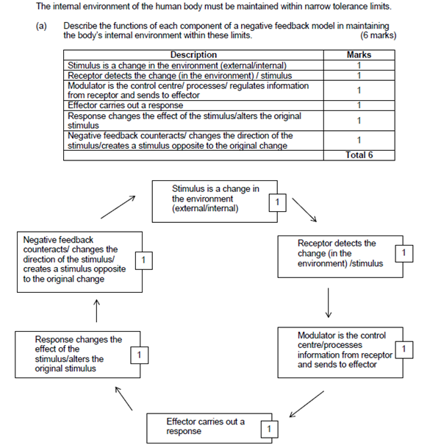
Question 1

Slide 3
Notes
Stimulus-definition
Lack of clarity in some definitions

Slide 4
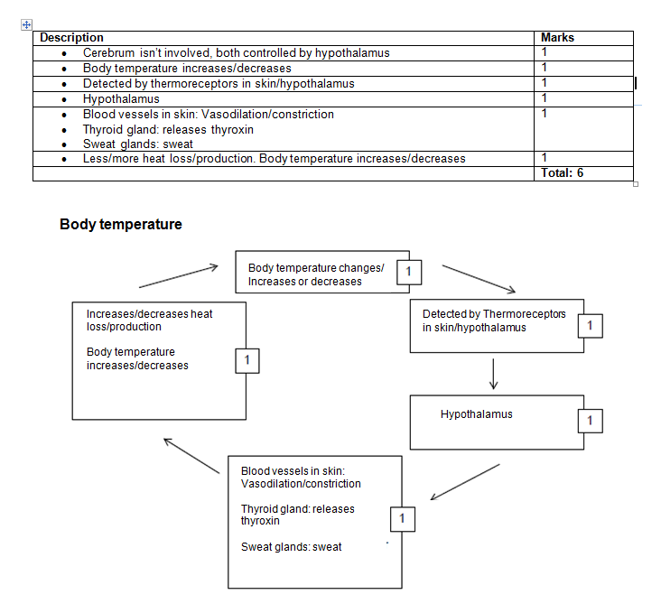

Slide 5


Slide 6
Notes
Too much writing-diagram and writing. Why are we doing both?
Structure is much better for most
Overall everyone did a great job-average of 81% ☺

